Slide 1
Calling Functions

Slide 2
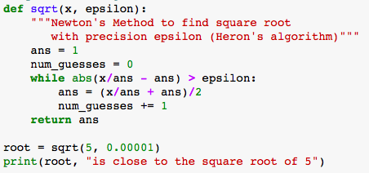
How Control Moves Through a Function
Think about how control moves through a program when you call a function.
Control begins moving from the top of our script, first the function is defined, then it gets to a statement with the first function call.
It can’t assign a value to root yet, because it doesn’t know the squareroot of 5 at this point.

Slide 3
How Control Moves Through a Function
At this point, we pause on executing the main program, and control jumps up to the start of the function.

Slide 4
How Control Moves Through a Function
We’re passing two objects into our function, 5 and 0.00001.
The function’s parameters, x and epsilon get bound to these two objects. So when control moves into the function, x will equal 5 and epsilon will equal 0.00001.

Slide 5
How Control Moves Through a Function
Now, control enters the function body and executes the statements in the function.
Eventually, control reaches the return statement. At this point, ans contains the value 2.236.

Slide 6
How Control Moves Through a Function
2.236
This value is passed back to the place the function was called.
Imagine that the sqrt function call is replaced with 2.236.
Now control returns to this part of the main program and can complete the statement, assigning 2.236 to the variable root.
Control then continues moving to the next statement and the program completes.

Slide 7
A Note on Terminology
Note that there’s a difference between parameters and arguments.
When we’re inside a function, we call the values passed in Parameters
But when we call a function from the outside, we call the values we pass in arguments.
People will understand you if you get these mixed up, but keep in mind that there is this difference.

